Slide 1
Hive and Data Warehousing
Week 3
Nasheb Ismaily
nismaily@bellevue.edu

Slide 2
Agenda
Introduction to Hive and its role in Big Data
Understanding HiveQL and its SQL-like querying on Hadoop
Hive ACID Transactions
Hive: Supported File and Data Types
Exploration of Data Warehousing concepts in Big Data

Slide 3
Hive: An Overview
Data warehouse infrastructure built on Hadoop
Developed by Facebook, later made open source
Provides an SQL-like interface (HiveQL) to data stored in Hadoop-compatible file systems

Slide 4
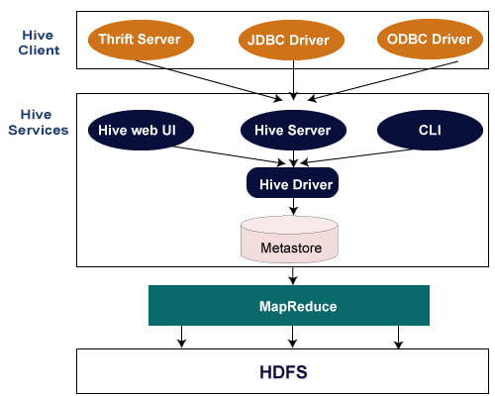
Architecture of Hive
Metastore: Stores metadata about Hive tables
Driver: Manages the lifecycle of a HiveQL statement
Compiler: Translates HiveQL into a plan of execution
Optimizer: Optimizes the plan from the Compiler
Executor: Executes the tasks in order of dependencies

Slide 5
Hive in Big Data Analytics
Handles structured and semi-structured data in Big Data environments
HiveQL: SQL-like syntax for querying the data
MapReduce: Custom MapReduce code can be written for more sophisticated analysis

Slide 6
Introduction to HiveQL
HiveQL: SQL-like query language for Hadoop
Abstracts the complexity of Hadoop
Allows running SQL-like queries on large volumes of data

Slide 7
HiveQL on Hadoop
Command-line interface: Used to execute HiveQL commands on Hadoop
Example: 'SELECT * FROM table_name' fetches all data from the table
HiveQL makes Hive a powerful tool for managing and querying large data sets

Slide 8
Hive ACID Transactions
ACID: Atomicity, Consistency, Isolation, Durability
Hive ACID transactions help in reading and writing data simultaneously, supporting real-time queries and data
ACID transactions in Hive are important for maintaining data integrity

Slide 9
Hive: Supported File and Data Types
Hive supports various file formats like Text File, SequenceFile, ORC, Parquet, and Avro
Hive supports primitive data types like INT, FLOAT, DOUBLE, STRING, and complex data types like arrays, maps, and struct

Slide 10
Data Warehousing in Big Data
A system used for reporting and analyzing data
Provides a unified view of data from different sources
Helps businesses make data-driven decisions

Slide 11
Data Warehousing Concepts in Big Data
Techniques: ETL process, data marts, OLAP
Hive Support: Schema storing in a database, processed data into HDFS
Enables data cleaning, integration, and consolidation

Slide 12
Conclusion
Hive's Role: Simplifies Big Data analytics, providing an SQL-like interface
Data Warehousing: Transforms raw data into actionable insights

Slide 13
A private, non-profit institution founded in 1966, Bellevue University is accredited by the Higher Learning Commission through the U.S. Department of Education. For general information, please call 800.756.7920. Email: nismaily@bellevue.edu bellevue.edu

